Slide 1
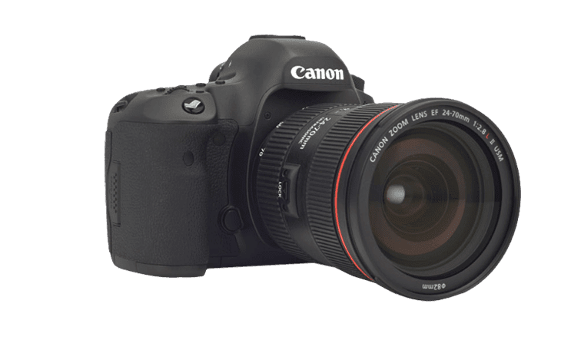

The invention of the DSLR
Alexandre MAURICE, 9th September 2021
BSc in computing, Semester 1

Slide 2
What is the invention/discovery?
What is it used for?
Why is it important?
How did people manage before they had this invention/discovery?

Slide 3
